Slide 1
CSE 414 Internet and Web Programming
Lecture 02: Socket Programming
MIU | CSE
Spring 2020

Slide 2


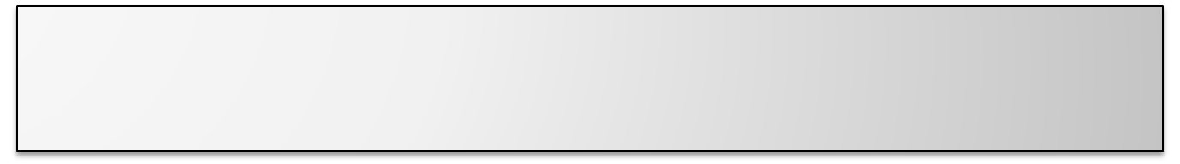
What is Socket?
a host-local, application-created, OS-controlled interface (a “door”) into which application process can both send and receive messages to/from another application process
provides an interface for programming networks at the transport layer
application
socket
application
controlled by
app developer
process
process
transport
transport
network
network
controlled
by OS
link
Internet
link
physical
physical
Socket-based communication is language independent, that is, a socket program written in Java can communicate to a program written in C or C++.

Slide 3

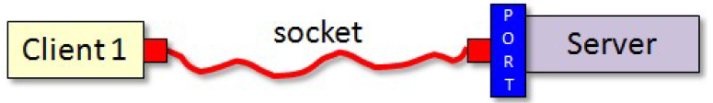
TCP Sockets
TCP provides reliable point-to-point communication
The client and server must establish a connection in order to communicate.
To do this, each program binds a socket to its end of the connection.
  socket is one endpoint of a two way communication link between two programs running on the network
  bound to a port number so that the TCP layer can identify the application to which the data is to be sent

Slide 4
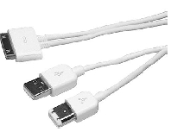
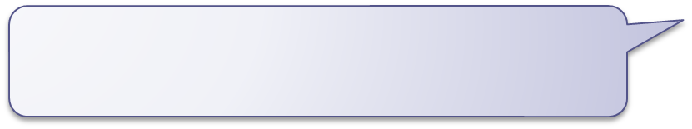
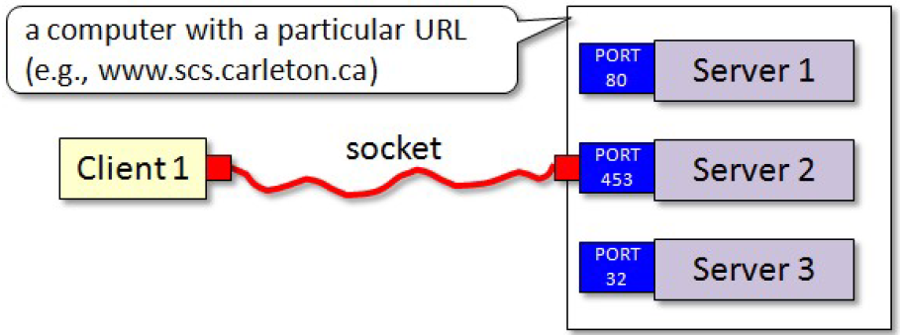
TCP Sockets (cont.)
The port number is used as the server's location on the
machine that the server application is running.
If a computer is running many different server applications
on the same physical machine, the port number uniquely identifies the particular server that the client wishes to communicate with.
a computer with a particular URL (e.g., www.miu.edu)

Slide 5

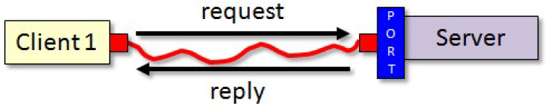
TCP Sockets (cont.)
The client and server may then each read and write to
the socket bound to its end of the connection.

Slide 6
Socket Programming in Java
Java provides a set of key classes, interfaces, and exceptions defined in java.net package those simplify the complexity involved in creating client and server programs.
The Classes
ContentHandler
DatagramPacket
DatagramSocket
DatagramSocketImpl
HttpURLConnection
InetAddress
MulticastSocket
ServerSocket
Socket
SocketImpl
URL
URLConnection
URLEncoder
URLStreamHandler
The Interfaces
ContentHandlerFactory
FileNameMap
SocketImplFactory
URLStreamHandlerFactory
Exceptions
BindException
ConnectException
MalformedURLException
NoRouteToHostException
ProtocolException
SocketException
UnknownHostException
UnknownServiceException

Slide 7
Java Internet Addresses
java.net.InetAddress class
Handles Internet Addresses both as host names and as IP addresses
Methods for name/address conversion:
    public static InetAddress getByName(String host) throws UnknownHostException
    public static InetAddress[] getAllByName(String host) throws UnknownHostException
    public static InetAddress getLocalHost() throws UnknownHostException
Other Methods:
    public booleanisMulticastAddress()
    public String getHostName()
    public byte[] getAddress()
    public String getHostAddress()
    public inthashCode()
    public booleanequals(Object obj)
    public String toString()

Slide 8
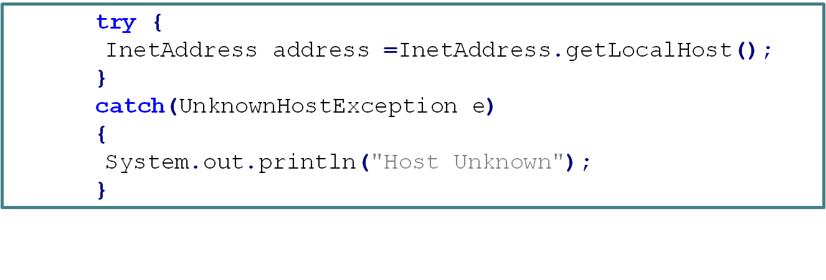
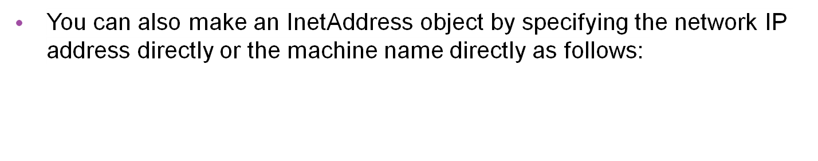
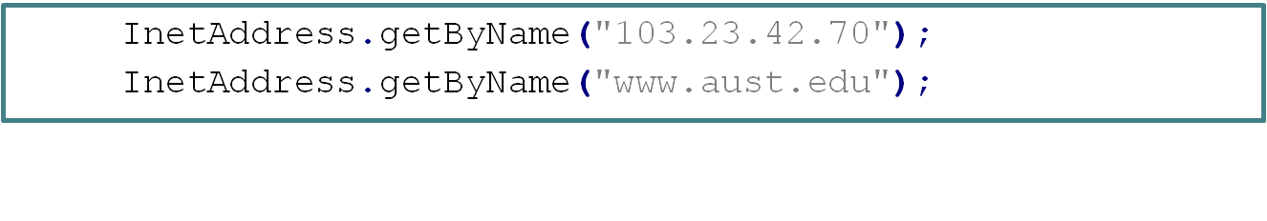
Java Internet Addresses (cont.)
If the server and client are on the same machine, the static method getLocatHost() may be used to get an address representing the local machine as follows:

Slide 9
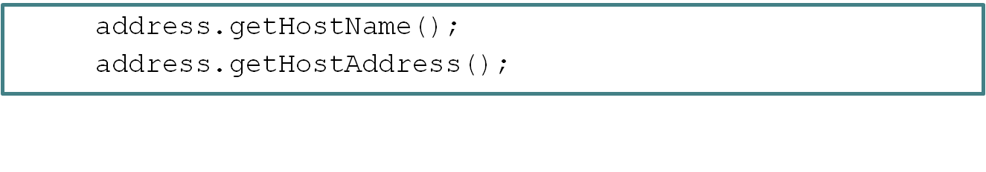
JAVA-Printing Internet Addresses
You get information from an InetAddress by using methods:

Slide 10
The Java.net.Socket Class
Connection is accomplished through the constructors. Each Socket object is associated with exactly one remote host. To connect to a different host, you must create a new Socket object
    public Socket(String host, int port) throws UnknownHostException, IOException
    public Socket(InetAddress address, int port) throws IOException
    public Socket(String host, int port, InetAddress localAddress, int localPort) throws IOException
    public Socket(InetAddress address, int port, InetAddress localAddress, int localPort) throws IOException
Sending and receiving data is accomplished with output and inputstreams. There are methods to get an input stream for a socket and an output stream for the socket
    public InputStream getInputStream() throws IOException
    public OutputStream getOutputStream() throws IOException
There is a method to close a socket
    public void close() throws IOException

Slide 11
The Java.net.ServerSocket Class
The java.net.ServerSocket class represents a server socket. It is constructed on a particular port. Then it calls accept() to listen for incoming connections
  accept() blocks until a connection is detected
  then accept() returns a java.net.Socket object that is used to perform the actual communication with the client.
    public ServerSocket(int port) throws IOException
    public ServerSocket(int port, int backlog) throws IOException
    public ServerSocket(int port, int backlog, InetAddress bindAddr) throws IOException
    public Socket accept() throws IOException [BLOCKING]
    public void close() throws IOException

Slide 12

TCP Server
The steps for creating a simple server program are:
Open the Server Socket
  ServerSocket serverSocket = new ServerSocket ( SERVER_PORT );
Wait for the client request
  Socket aClientSocket = serverSocket.accept();
Communicate with the client
Close the socket
  aClientSocket.close();
So how do we actually communicate with the client?

Slide 13
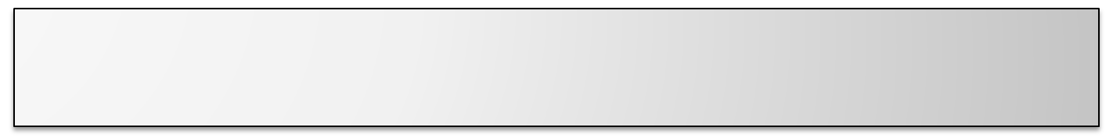
Create I/O Streams for communication
each socket has an inputStream and an outputStream
once we have the sockets, we simply ask for these streams:
  InputStream in = socket.getInputStream(); OutputStream out = socket.getOutputStream();
A stream is a sequence of characters that flow into or out of a process. An input stream is attached to some input source for the process, e.g., keyboard or socket. An output stream is attached to an output source, e.g., monitor or socket.

Slide 14
Create I/O Streams for Communication (Cont.)
Normally, however, we actually wrap these input/output streams with text-based, data type based or object-based wrappers:
  ObjectInputStream in = new ObjectInputStream(socket.getInputStream());
  ObjectOutputStream out = new ObjectOutputStream( socket.getOutputStream());
  BufferedReader in = new BufferedReader(new InputStreamReader( socket.getInputStream()));
  PrintWriter out = new PrintWriter(socket.getOutputStream());
  DataInputStream in = new DataInputStream(socket.getInputStream());
  DataOutputStream out = new DataOutputStream (socket.getOutputStream());

Slide 15
Perform Communication
Once we set up the input and output streams then reading and writing may occur
We read from a socket via input stream
  BufferedReader inFromClient = new BufferedReader(new InputStreamReader (serverSocket.getInputStream()));
  String clientMessage = in.readLine();
We write to a socket via output stream
  DataOutputStream outToClient = new DataOutputStream(serverSocket.getOutputStream());
  outToClient.writeBytes(“Hello From Server\n”);

Slide 16
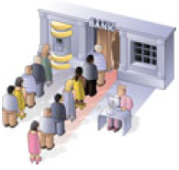
TCP Client
The steps for creating a simple client program are:
Establish a connection to the server
  Socket clientSocket = new Socket(inetAddress, SERVER_PORT);
Communicate with the server
Close the socket
  clientSocket.close();
So how do the client communicate with the server?
  This time we Know the answer! Same as TCP server

Slide 17


Interaction Between Server and Client
Server
Client
create socket for
incoming request:
serverSocket =
new ServerSocket(PORT)
TCP
connection setup
create socket,
connect to server
wait for incoming
connection request
aClientSocket =
serverSocket.accept()
clientSocket =
Socket(inetAddress, PORT)
send request using
clientSocket
read request from
aClientSocket
write reply to
aClientSocket
read reply from
clientSocket
close
aClientSocket
close
clientSocket

Slide 18
Now we are ready to develop a complete server-client app

Slide 19
Example server-client app
client reads line from standard input, sends to server via socket
server reads line from socket
server converts line to uppercase, sends back to client
client reads, prints modified line from socket

Slide 20
TCPServer
import java.io.*;
import java.net.*;
class TCPServer {
public static void main(String argv[]) throws IOException
{
String clientSentence;
String capitalizedSentence;
ServerSocket welcomeSocket = new ServerSocket(6789);
while(true) {
Socket connectionSocket = welcomeSocket.accept();
BufferedReader inFromClient =
new BufferedReader(new InputStreamReader(
connectionSocket.getInputStream()));
Create welcoming
socket at port 6789
Wait, on welcoming
socket for contact by client
Create input
stream, attached to socket

Slide 21
TCPServer (Cont.)
Create output stream, attached to socket
  DataOutputStream outToClient =
  new DataOutputStream(
  connectionSocket.getOutputStream());
  clientSentence = inFromClient.readLine();
  capitalizedSentence =
  clientSentence.toUpperCase()+'\n';
  outToClient.writeBytes(capitalizedSentence);
  connectionSocket.close();
}
}
}
Read in Line from socket
Write out Line to socket
End of while loop,
loop back and wait for
another client connection

Slide 22
TCPClient
import java.io.*;
import java.net.*;
class TCPClient {
public static void main(String argv[]) throws IOException
{
String sentence;
String modifiedSentence;
BufferedReader inFromUser = new
BufferedReader(new InputStreamReader(System.in));
Socket clientSocket = new Socket(“localhost", 6789);
DataOutputStream outToServer = new
DataOutputStream(clientSocket.getOutputStream());
Create input stream
Create client socket,
connect to server
Create output stream
attached to socket

Slide 23
TCPClient (Cont.)
Create input stream
attached to socket
BufferedReader inFromServer = new BufferedReader( new InputStreamReader(clientSocket.getInputStream()));
sentence = inFromUser.readLine();
outToServer.writeBytes(sentence + '\n');
modifiedSentence = inFromServer.readLine();
System.out.println("FROM SERVER: " + modifiedSentence);
clientSocket.close();
}
}
Send line to server
Read line from server

Slide 24
How to run TCPServer and TCPClient on your machine
To run on Terminal or Command Prompt
Compline both TCPServer and TCPClient
  javac TCPServer.java
  javac TCPClient.java
First run the TCPServer in one terminal
  java TCPServer
Then run the TCPClient in another terminal
  java TCPClient
Then you can start typing in the client window
If you’re using NetBeans or likes of such
Compile both of them on two different terminals or tabs
Run the Server program first
Then run the Client program
Type messages in the Client
Window which will be received
and showed by the Server
Window. Also the response will
be shown in the client window

Slide 25
Now It’s time to implement a more comprehensive network app

Slide 26


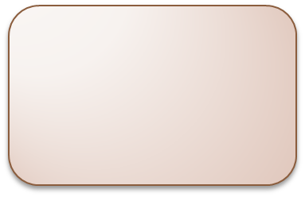
A Simple Online Calculator using TCP
You have to implement a simple online calculator that can perform simple mathematical operations
The client will send requests to server in form of simple arithmetic equations
Server will respond back with the answer to the equation
Server
(add, sub, div, etc.)
15 + 5
Client 1
What is the value of 15 + 5 ?
20
15 * 5
15 / 5
3
75
Client 2
What is the value of 15 * 5 ?
Client 3
What is the value of 15 / 5 ?

Slide 27
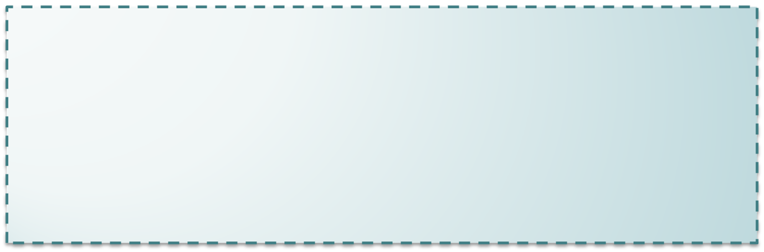
Implementation
First we define a interface CalcInterface which declares four methods add, sub, div and mul for addition, subtraction, division and multiplication operation, respectively.
CalcInterfaceImpl implements CalcInterface interface and defines its abstract methods.
CalcServer receives the equation, processes it and returns the result back to client.
CalcServer is pretty similar to the server of previous example.
The difference is that we define the protocol for the server
and client communication as,
first_value operator second_value,
which is same as the form of a simple arithmetic equation.
It is the math server’s responsibility to understand this protocol and
delegate to the proper methods such as add, sub, mul, or div.

Slide 28
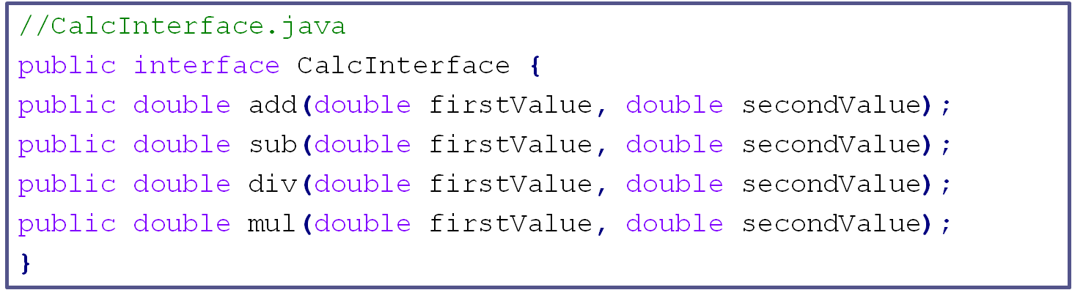
CalcInterface interface

Slide 29
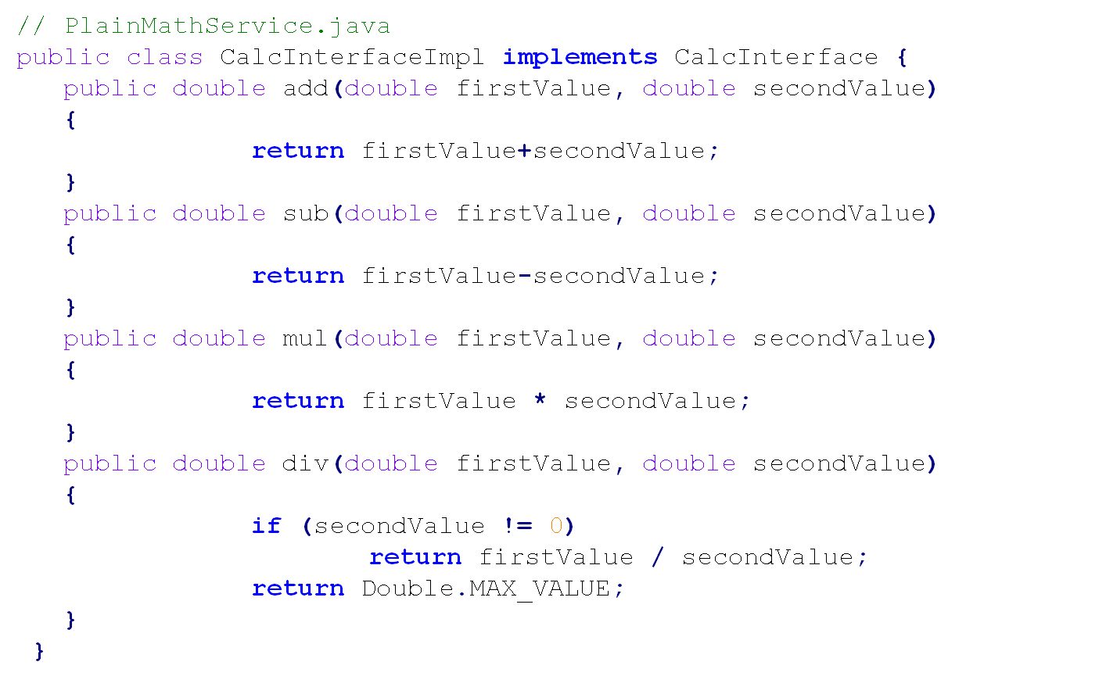
A Simple Implementation of CalcInterface

Slide 30
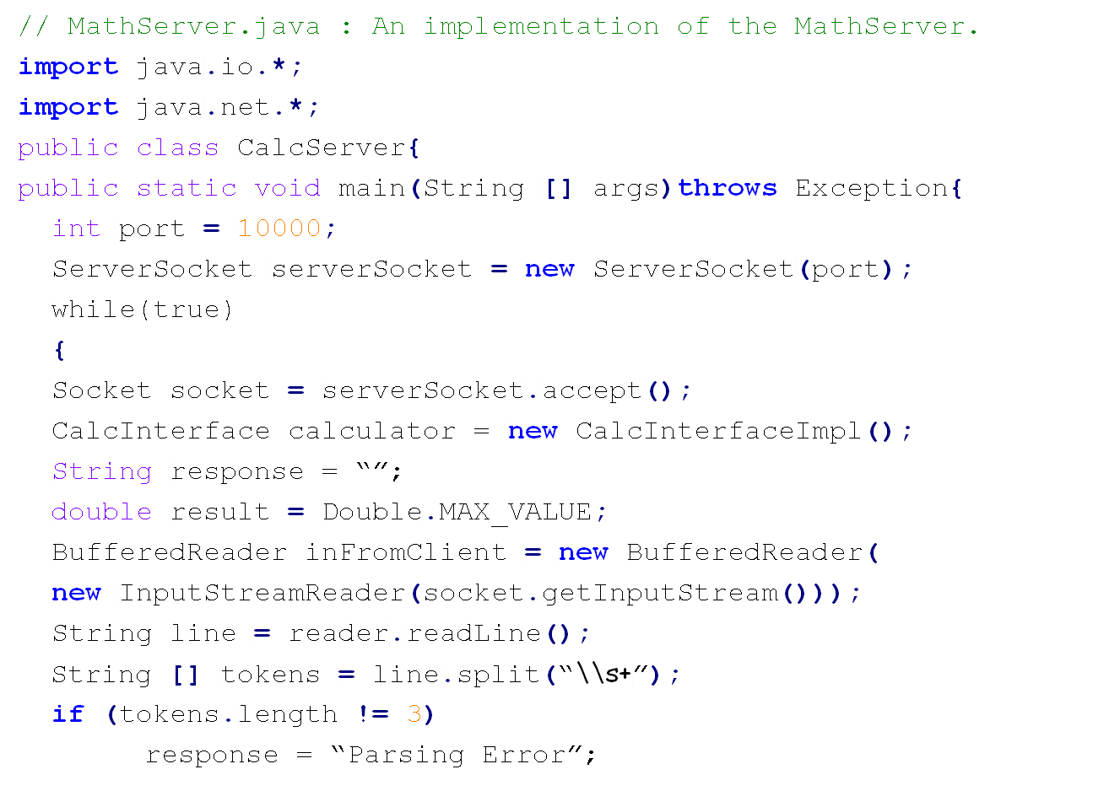
Implementation of CalcServer
any number of consecutive spaces
split your string into tokens

Slide 31
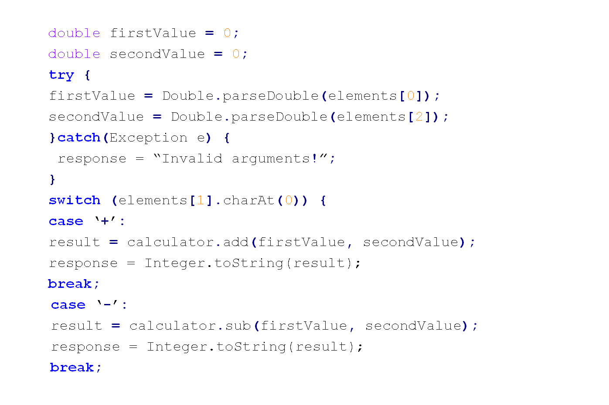
Implementation of CalcServer(Cont.)

Slide 32
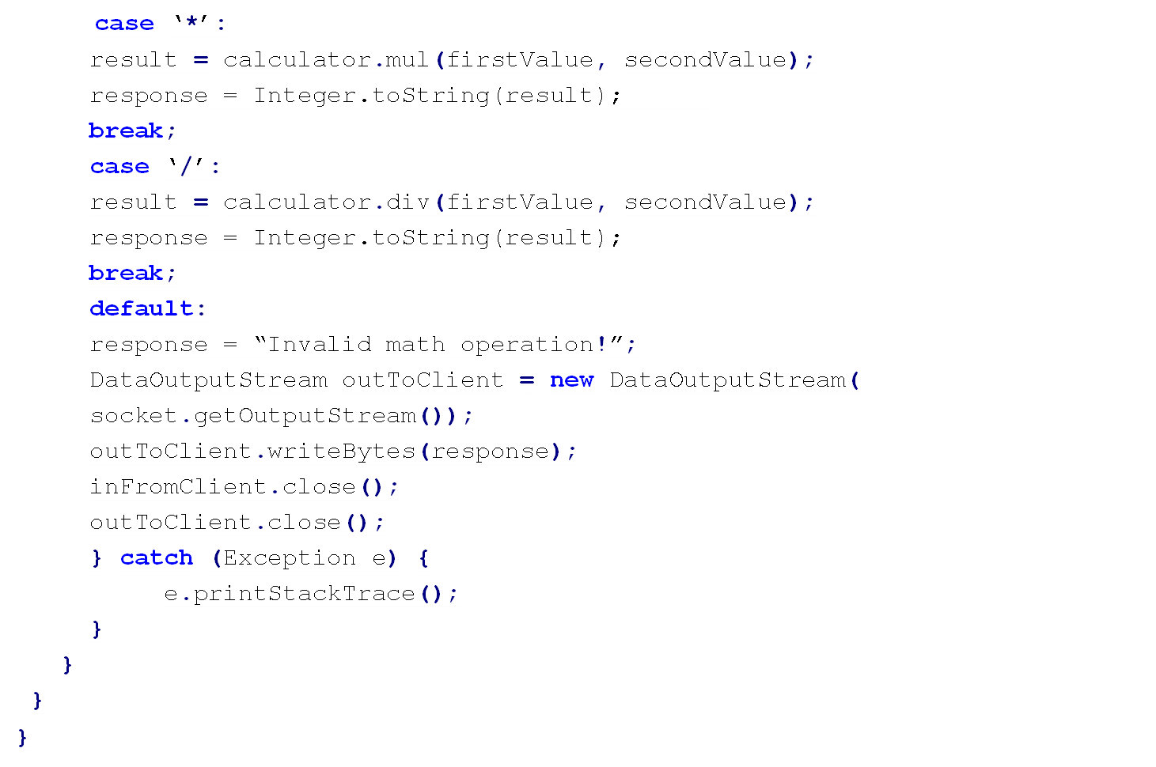
Implementation of CalcServer(Cont.)

Slide 33
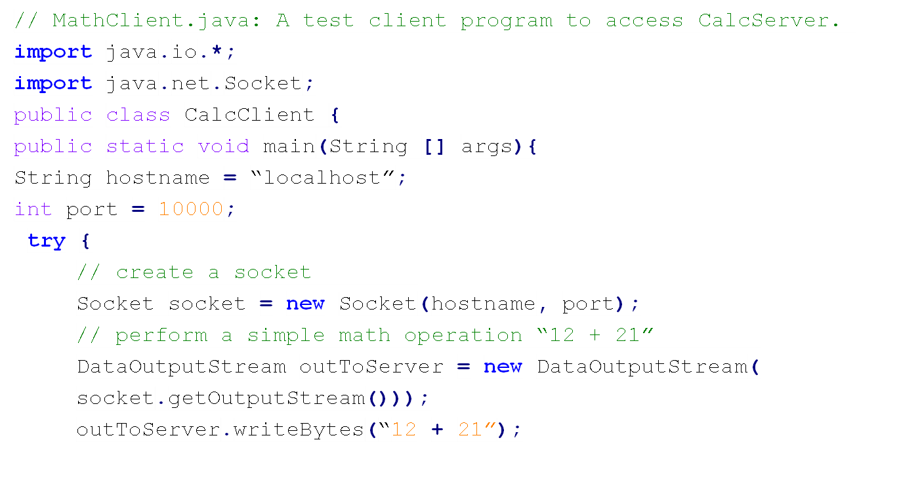
A Test Client

Slide 34
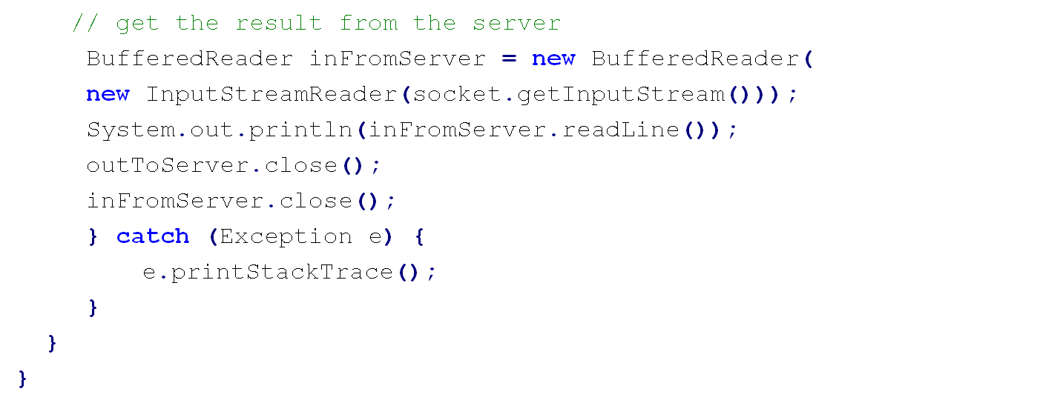
A Test Client (Cont.)

Slide 35
References:
Chapter 02 from Jim Kurose and Keith Ross, Computer Networking: A Top Down Approach Featuring the Internet, 6th edition, Addison-Wesley, March 2012.
Chapter 13 from Rajkumar buyya, Object Oriented Programming with Java: Essentials and Applications.

